Slide 1
Oracle Financials
Account Receivables
Toshiba Information Equipment Phils.,Inc.
2023.07.24
Scope of Disclosure | within TIP only
Head of Information Owner Section | TIP

Slide 2
Account Receivable
What is AR?
The stages in GAIA Interfacing
AR PROCESS FLOW
COMMON SETUP IN AR

Slide 3
Account Receivable (AR)
The proceeds of the company which is paid by the customer who has purchased its goods, services, etc.

Slide 4
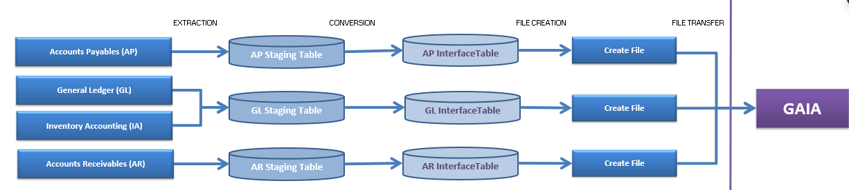
The stages of GAIA Interfacing
Extraction
Conversion
Data file creation
Data file transfer

Slide 5
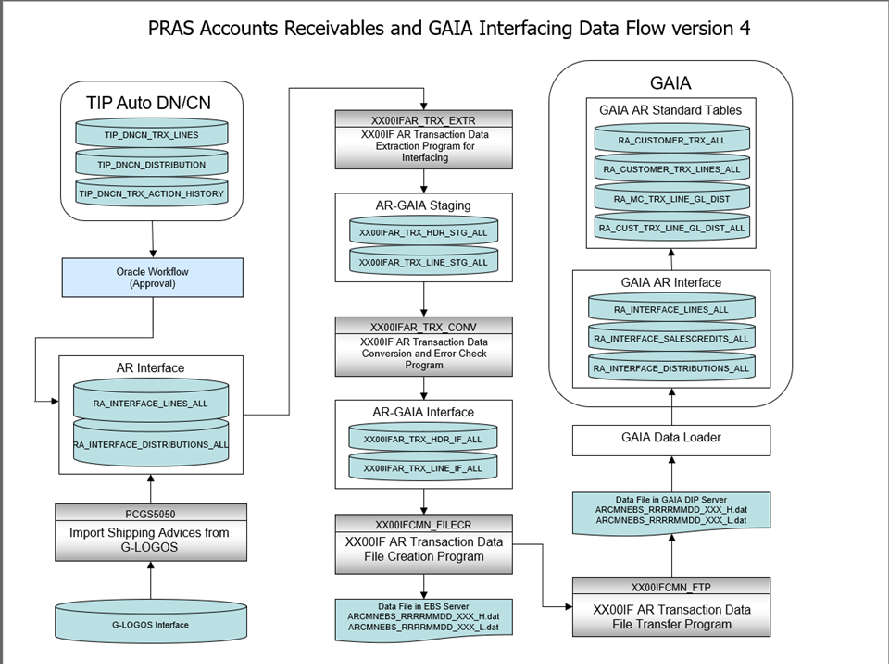

Slide 6
TIP AUTO DN/CN
DEBIT NOTE -A Debit Note is a document issued by a buyer to a seller, indicating that the buyer is increasing the amount owed to the seller. It is typically used when there is an undercharge, missing billing, additional products or services received, or any other reason that requires an increase in the amount payable to the seller by the buyer.
For instance, if a buyer receives more products than initially ordered or if there is an undercharged amount, the buyer will issue a Debit Note to increase the accounts payable to the seller and adjust the financial records accordingly.
CREDIT NOTE - A Credit Note is a document issued by a seller to a buyer, indicating that the seller is reducing the amount owed by the buyer. It is usually sent when there is an overcharge, incorrect billing, product return, or any other reason that requires a reduction in the amount payable by the buyer to the seller. In other words, it serves to give credit back to the buyer's account or reduce the outstanding balance.
For example, if a customer returns a product, the seller will issue a Credit Note to reduce the customer's accounts payable and reflect the return in the financial records.

Slide 7
SHIPPING ADVICE
Shipping advice, also known as a shipping notification or shipping confirmation, is a communication sent to a customer or recipient to provide important information about a shipped item or package. This notification is typically sent by the sender
Shipment Details
Origin and Destination
Carrier Information
Shipping Method
Description of Goods
Delivery Instructions
Estimated Delivery Time
Tracking Information
Contact Information

Slide 8
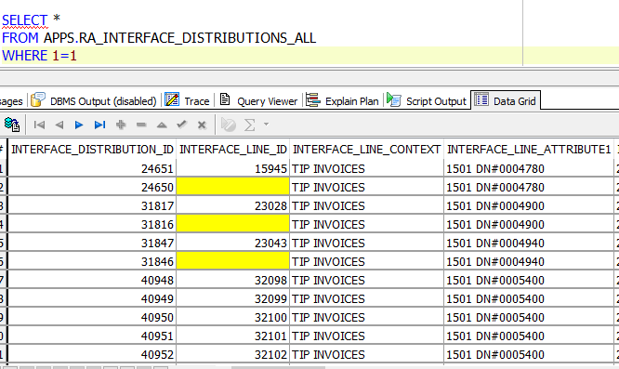
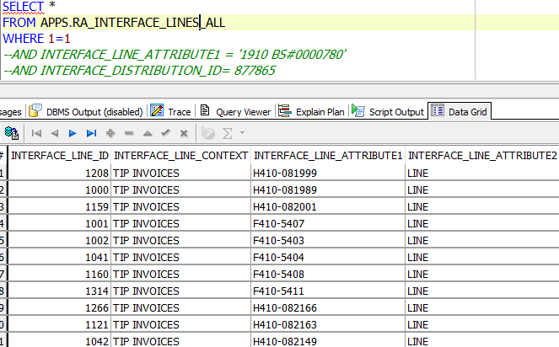

Slide 9
AR Interface Extraction – High-level Process Diagram
GLOGOS
AUTO DN/CN
Transaction
Source = ‘T090593_000_0007’
(TIP Invoice)
Read AR Interface Records
NO
AR EBS Interface Table
RA_INTERFACE_LINES_ALL
Read AR interface which records are not processed. records. (RA_INTERFACE_LINES_ALL.ATTRIBUTE11 is not ‘I’)
RA_INTERFACE_DISTRIBUTIONS_ALL
YES
Read Sales Person to derive SBU, Site, Center and Product Category
Salesperson
Assume;
G-LOGOS (SA Import) inserts both RA_INTERFACE_LINES_ALL and RA_INTERFACE_SALESCREDITS_ALL as well. Read and use only RA_INTERFACE_LINES_ALL
AUTO DN/CN inserts both RA_INTERFACE_LINES_ALL and RA_INTERFACE_DISTRIBUTIONS_ALL.
YES
Error
NO
①
Read Transaction Type to derive Natural Account and Subaccount
Transaction Type
Insert into AR Staging tables
YES
Error
Although it is not explicitly described, any error during process should go to error process to set update the processing status.
NO
Read Customer Site (Bill-to) to derive Intercompany & Partner
Customer Site
① In case of AUTO DN/CN RA_INTERFACE_DISTRIBUTIONS_ALL can be used to populate the GAIA based AFF values.
YES
Error
NO
Read Customer Site (Ship-to) and System table to derive Region & Others
System Default Master
Set process status to ‘E’(Error)
(RA_INTERFACE_LINES_ALL_ATTRIBUTE11)
YES
Error
NO
Insert into AR Staging tables
XX00IFAR_TRX_HDR_STG_ALL
Set process status to ‘I’(Interfaced)
(RA_INTERFACE_LINES_ALL_ATTRIBUTE11)
XX00IFAR_TRX_LINE_STG_ALL

Slide 10
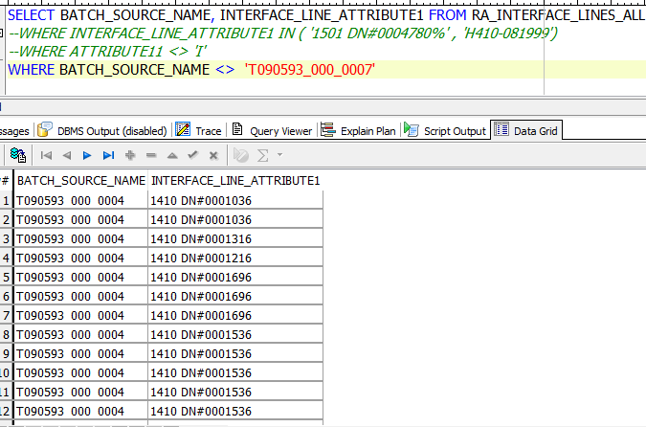
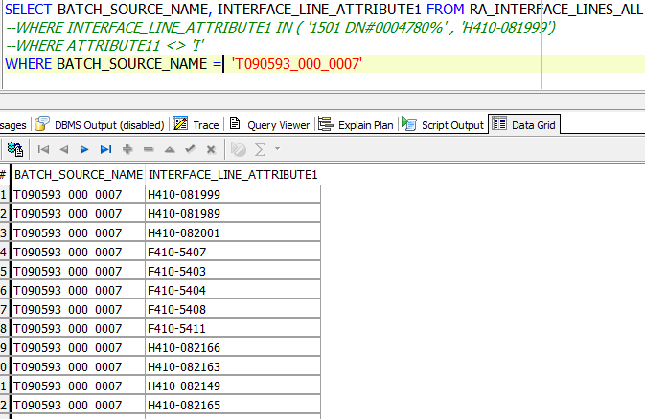

Slide 11
PROGRAM
xx00ifar_interface_conc_sv_tip.main_extr (EXTRACTION)
xx00ifar_interface_conc_sv.main_conv (CONVERSION)
xx00ifcmn_func_util_sv.flatfile_creation (DATA FILE CREATION)
XX00IFCMN_FTP (DATA FILE TRANSFER)

Slide 12
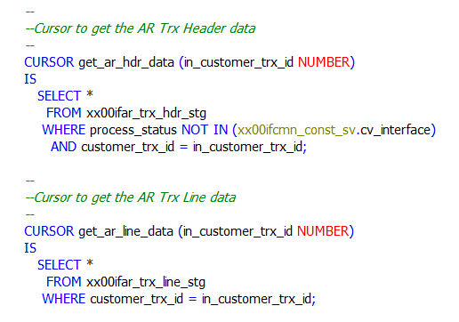
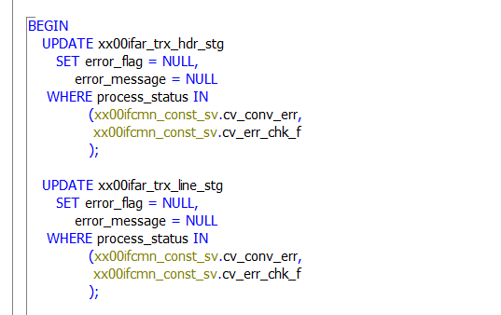

Slide 13
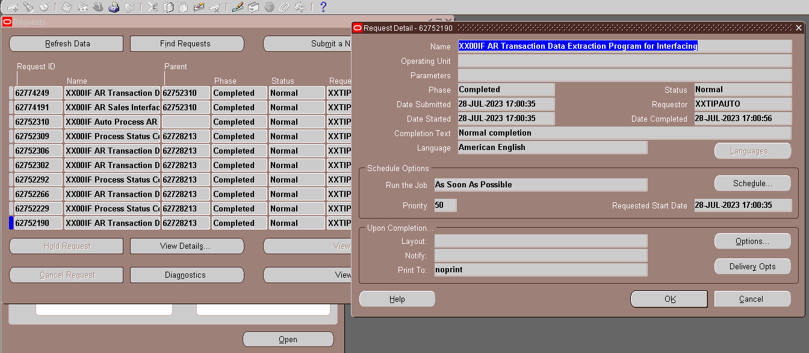
AR Auto Process

Slide 14
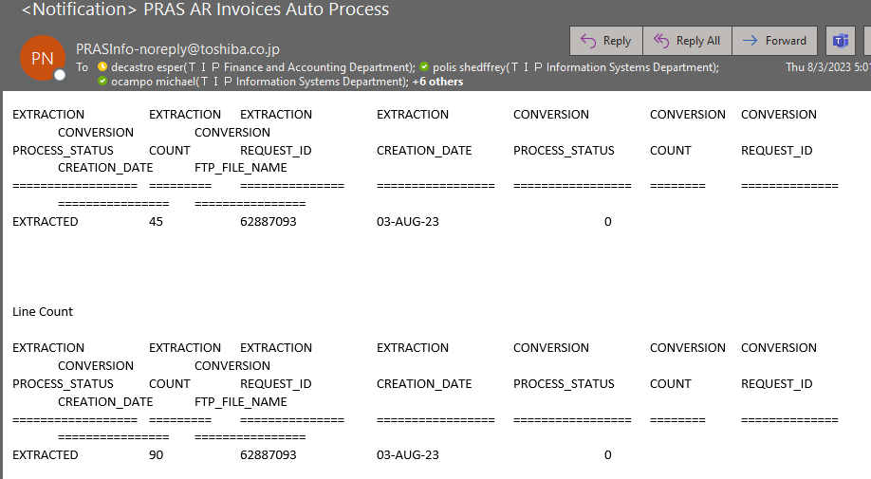
AR Auto Process email

Slide 15
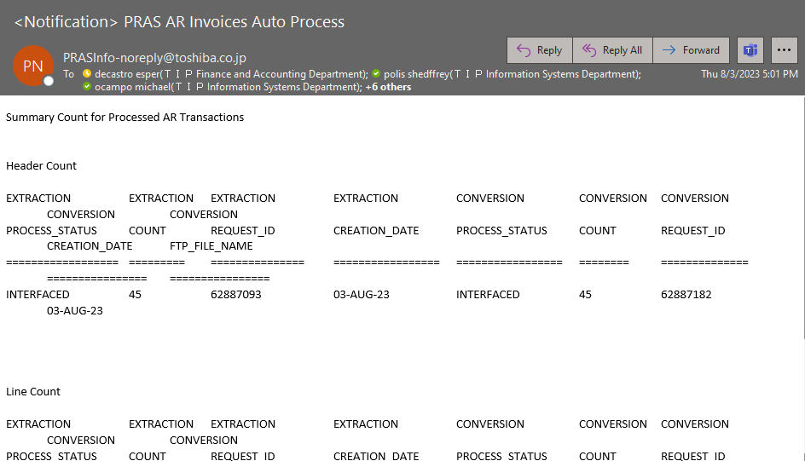
AR Auto Process email

Slide 16
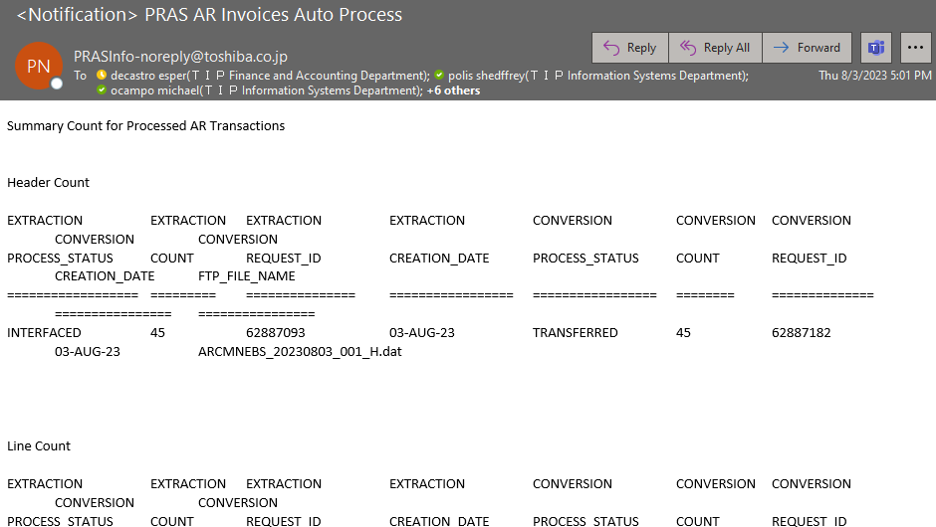
AR Auto Process email

Slide 17
TORICO CODE SET-UP

Slide 18
END

